Slide 1


Samsung R&D Vietnam (SRV)
Identity and Access
Management System
Ha Noi, May 25th 2024

Slide 2


Group 18
Member:
Hoang Thanh Lam
Duong Xuan Bach
Mentor:
Vu Trung Quan
Vu Khac Chinh

Slide 3

Assignment Table
Hoang Thanh Lam | Technology Research and Exploration (IAM, OAuth2, OpenID Connect, ... ) Code Front-end (ReactJS) Slide presentation
Duong Xuan Bach | Technology Research and Exploration (OAuth2, OpenID Connect , ... ) Code Back-end (Java Spring Boot) Write documentation

Slide 4

Outline
1. Problems
2. Background knowledge
3. Current Issue
4. Implementation and Testing
5. Result Demo

Slide 5




Problems
Overview
Managing and securing user identities and access.
Users have too many accounts and passwords to remember each time they access a website.
Security risk: Without the additional layer of verification provided by 2FA, a user's online accounts are generally less secure.

Slide 6
Problems
Research Objectives
Research and evaluate common authentication and authorization protocols (OAuth2, OpenID Connect, SAML 2.0).
Design and develop a secure, efficient, and scalable IAM system based on these protocols.
Utilize open-source solutions (IdentityServer, Keycloak, OWASP SSO, etc.) to implement the IAM system.

Slide 7


Web/Web Service
Framework : React, Spring Boot, MySQL, ...
The web relies on a client-server model where web browsers (clients) request information from web servers.
Web services allowing applications to communicate directly, exchanging data using standardized protocols like SOAP or REST APIs.
Background knowledge
Database
MySQL:
MySQL is a popular open-source relational database management system (RDBMS)
Programing
Protocols: OAuth2, OpenID Connect, SAML 2.0
Open sources: IdentityServer, Key Kloak, OWASP SSO

Slide 8
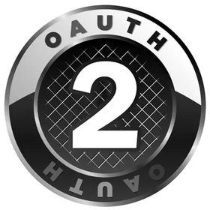
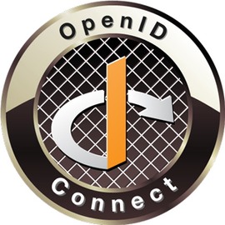
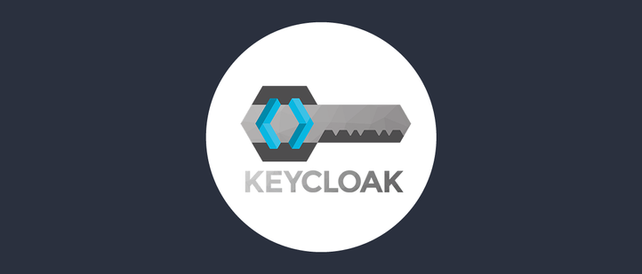
Current Solutions
OAuth2
OpenID Connect
Key Kloak
OAuth 2.0 is the industry-standard protocol for authorization. OAuth 2.0 focuses on client developer simplicity while providing specific authorization flows for web applications,
OpenID Connect is an interoperable authentication protocol based on the OAuth 2.0 framework of specifications
Keycloak is an open-source tool that acts as an Identity and Access Management (IAM) server

Slide 9
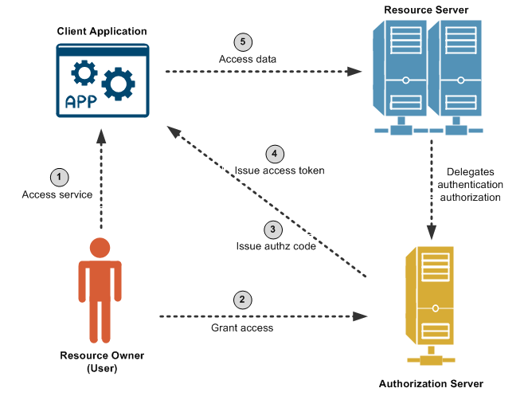
OAuth 2 Flow

Slide 10
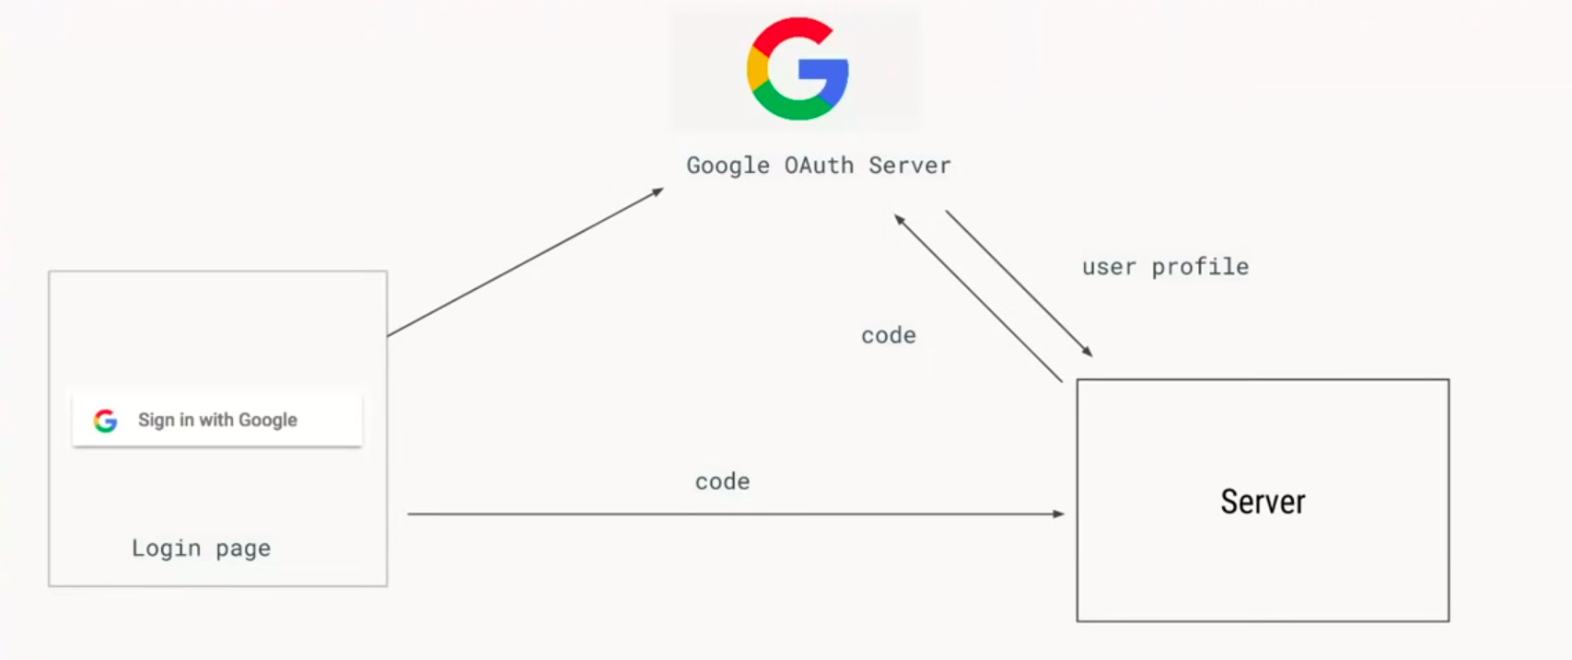
OpenID Connect Flow

Slide 11
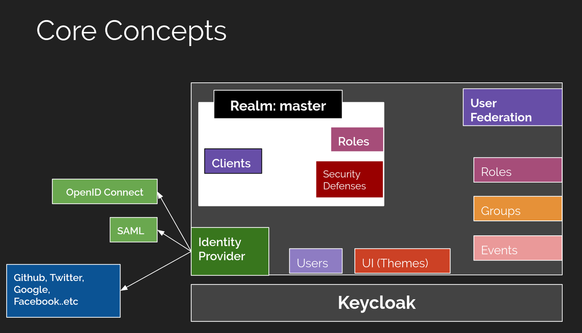
KeyCloak

Slide 12

 | Task
1 week | Research, read documentation Planing idea
2 weeks | Setup environment Choose technology
2 weeks | Design Database Design Web Service Architecture
2 weeks | Development and Implementation Testing and Fixing bug
Time
Implementation and Testing

Slide 13
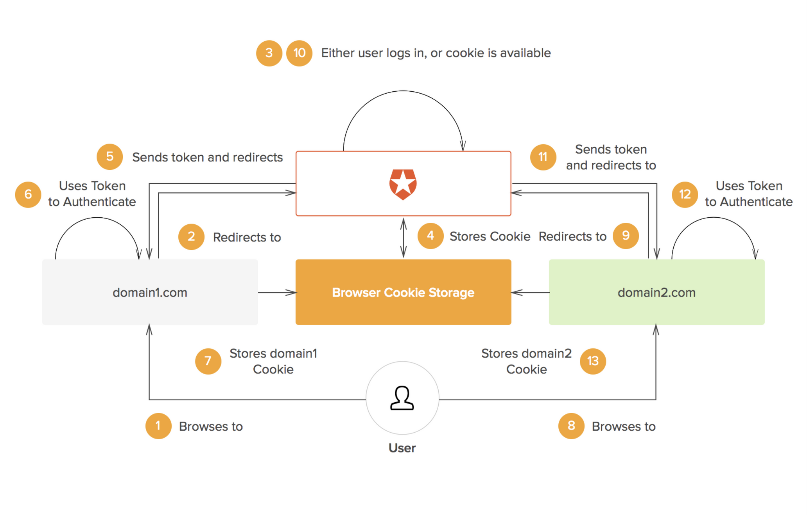
Single Sign On Flow

Slide 14
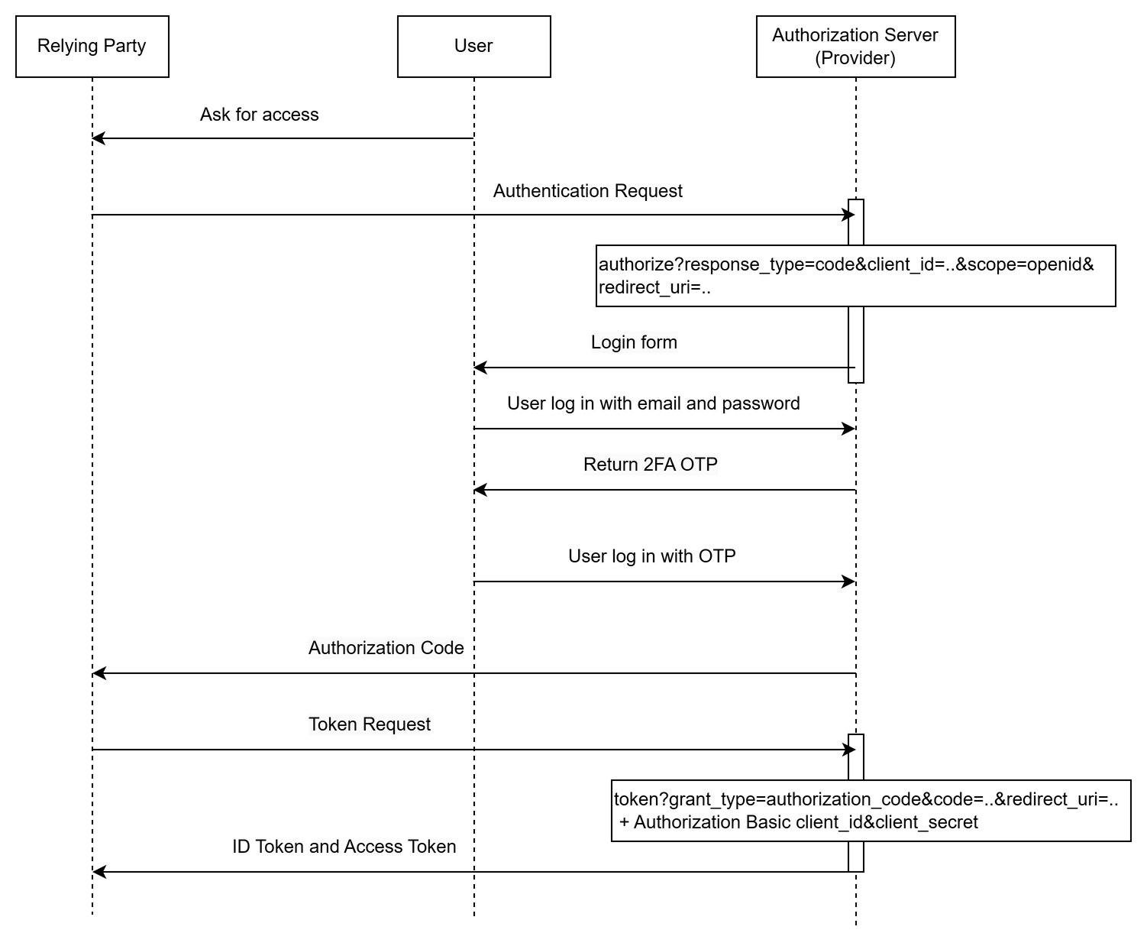
OpenID Connect authorization code flow.

Slide 15
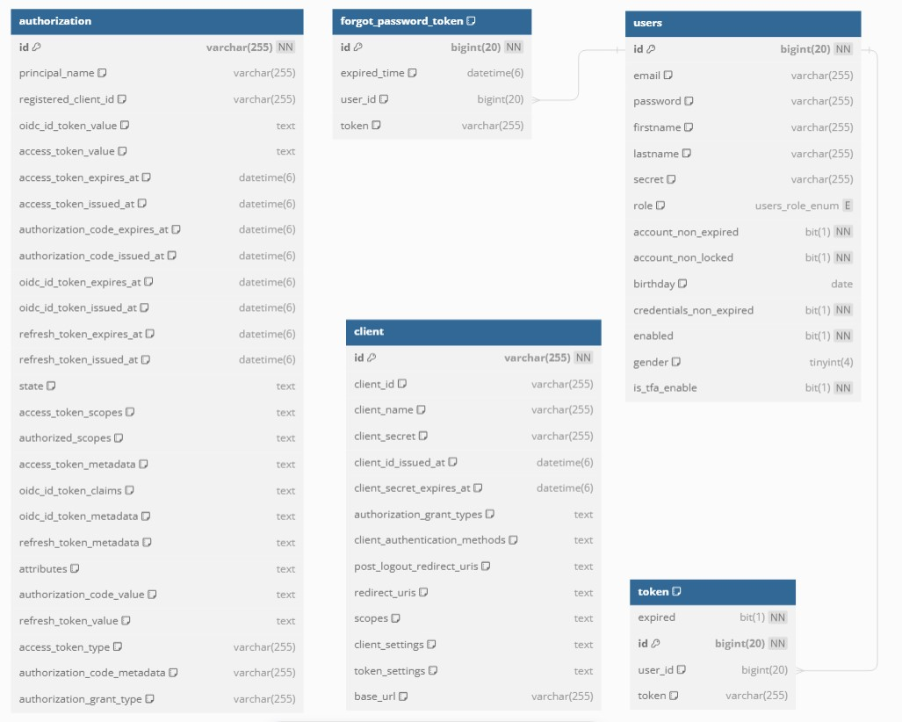
Database Design

Slide 16
Authorization Server
FrontEnd:
ReactJS
BackEnd:
Spring Framework
Spring Authorization Server
Database:
MySQL
Technology
Demo Client
Server Side Client:
Spring OAuth2 Client

Slide 17

Technology
Tổng quan
Trình bày một cách dễ dàng và khiến bất kỳ khán giả nào thán phục với Bản Thuyết Trình Canva. Chọn từ hơn một nghìn mẫu để phù hợp với bất kỳ mục tiêu hoặc chủ đề nào.
Lịch sử
Với Bản thuyết trình Canva, bạn có thể cộng tác theo thời gian thực với đồng đội hoặc người trình bày chung với bạn. Chia sẻ nhiệm vụ và công việc đồng thời để
tạo nên một bản thuyết trình xuất sắc.

Slide 18

Xin cảm ơn!
Các bạn có bất kỳ câu hỏi nào cho chúng tôi không?

